Slide 1

Model fitting and diagnostics for the Cox model
Steve Simon for
Notes:
Analyzing Repeated Measures Data Workshop: Module 5 The Linear Mixed Model
Copyright 2011 The Analysis Factor http://TheAnalysisFactor.com
1

Slide 2
Abstract
Lecture 4.
In this lecture, you'll work with more complex forms of the Cox model with multiple predictor variables. You'll include covariates in the Cox model to produce risk adjusted survival curves. You'll also assess the underlying assumptions of the Cox model, particularly the assumption of proportional hazards.

Slide 3
Multivariate Cox models
The advantages of multivariate models
A multivariate model offers several advantages.
Your predictions are better with two (or more) independent variables.
You can use covariates to make risk adjustments.
You can explore interactions among variables.

Slide 4
Multivariate Cox models
Always start with single variable models.
coef exp(coef) se(coef) z Pr(>|z|)
genderFemale 0.3815 1.4645 0.1376 2.773 0.00556
exp(coef) exp(-coef) lower .95 upper .95
genderFemale 1.464 0.6828 1.118 1.918

Slide 5
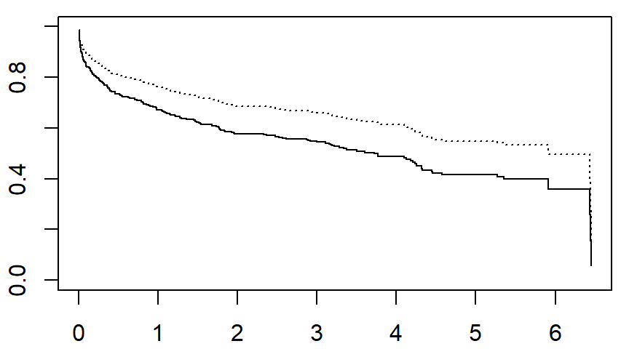
Cox model (male=dash, female=solid)

Slide 6
Cox model with age and gender
Add extra variables slowly
coef exp(coef) se(coef) z Pr(>|z|)
age 0.066928 1.069218 0.006196 10.802 <2e-16 genderFemale -0.066285 0.935864 0.140585 -0.471 0.637
exp(coef) exp(-coef) lower .95 upper .95
age 1.0692 0.9353 1.0563 1.082
genderFemale 0.9359 1.0685 0.7105 1.233

Slide 7
Multivariate Cox models
How are the two variables interrelated?
overall_mean
[1] 69.846
gender_means
Male Female
66.59667 74.72000

Slide 8
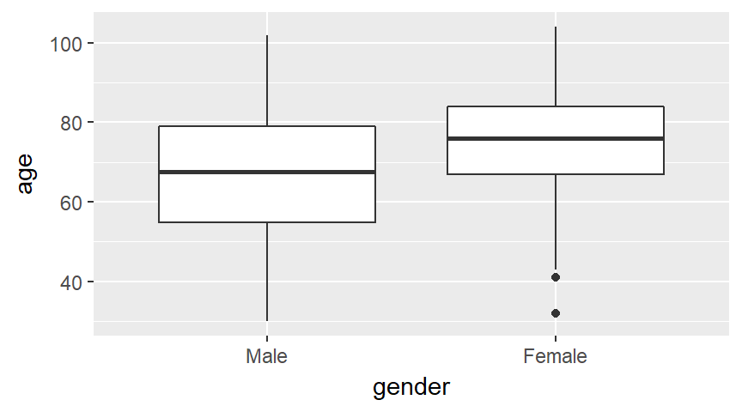
Multivariate Cox models

Slide 9
Multivariate Cox models
How are the two variables interrelated?
Notice that there is a 8.1 year difference between the average ages of men and women. The hazard ratio for age, 1.069, can get extrapolated to a 8.1 year difference by exponentiating. That is 1.069^8.1 = 1.72 which is actually larger than the hazard ratio that we saw for the unadjusted model with just gender.

Slide 10
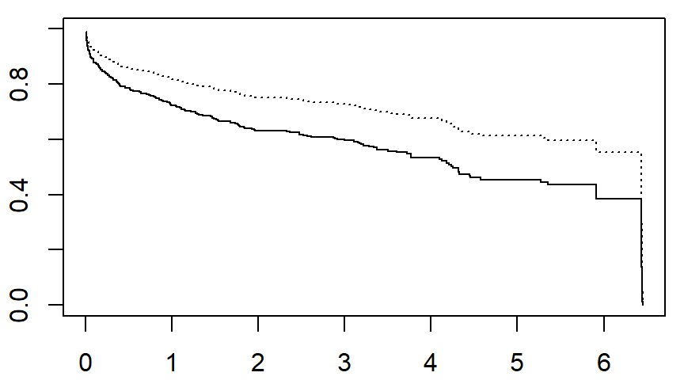
Survival for 74.7 year female, 66.6 year male

Slide 11
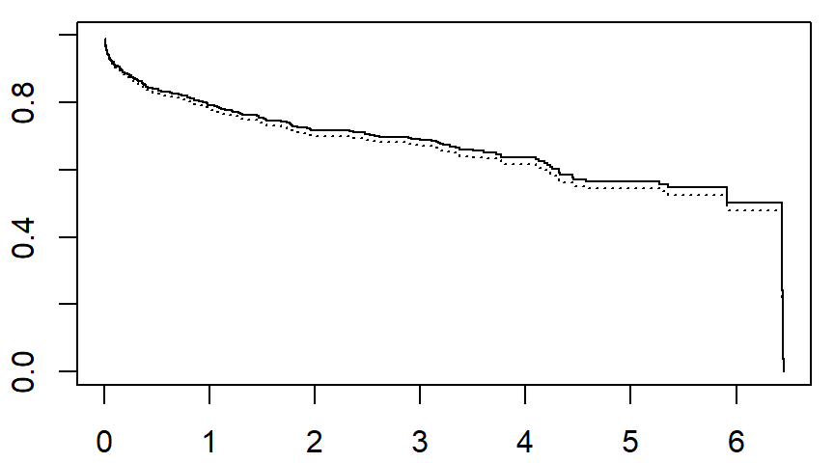
Survival for 69.8 year female, 69.8 year male

Slide 12
Cox model for body mass index (bmi)
First, calculate the univariate model
coef exp(coef) se(coef) z Pr(>|z|)
bmi -0.09847 0.90622 0.01475 -6.676 2.46e-11
exp(coef) exp(-coef) lower .95 upper .95
bmi 0.9062 1.103 0.8804 0.9328

Slide 13
Cox model for body mass index (bmi)
Then, calculate the multivariate model
coef exp(coef) se(coef) z Pr(>|z|)
bmi -0.042084 0.958789 0.015427 -2.728 0.00637
age 0.060791 1.062677 0.006503 9.348 < 2e-16
i_female -0.093065 0.911135 0.141085 -0.660 0.50949
exp(coef) exp(-coef) lower .95 upper .95
bmi 0.9588 1.043 0.9302 0.9882
age 1.0627 0.941 1.0492 1.0763
i_female 0.9111 1.098 0.6910 1.2014

Slide 14
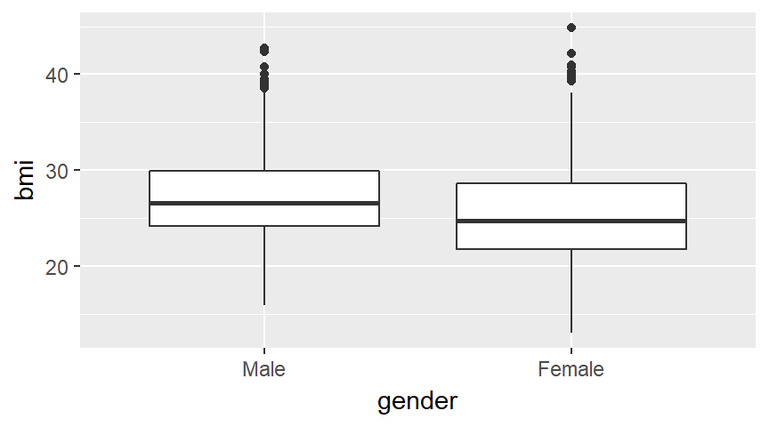
Examine interrelationships

Slide 15
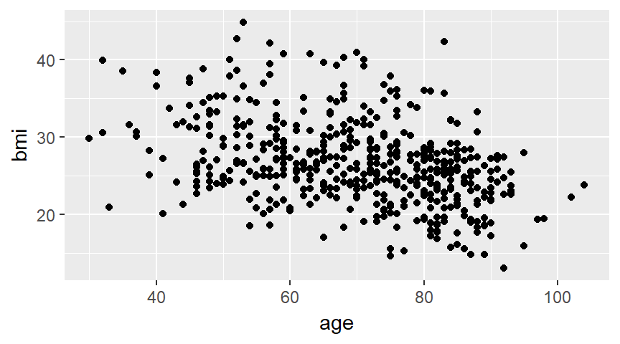
Examine interrelationships

Slide 16
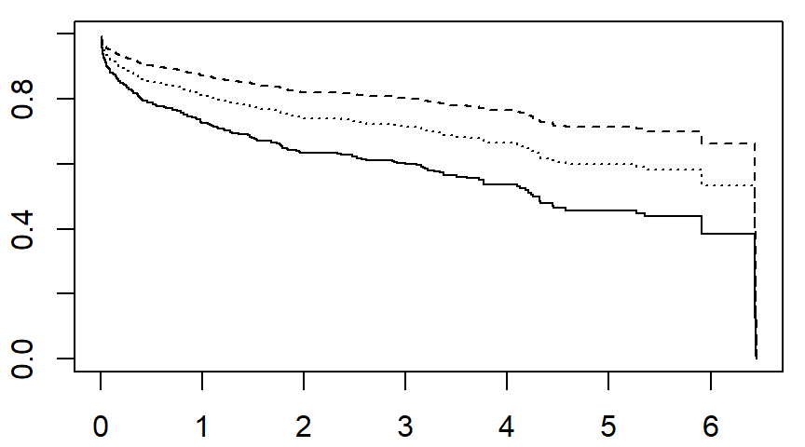
bmi=25, 35, 45 with age=69.8, i_female=0.3

Slide 17
Cox model for interaction
The default interaction model has problems
coef exp(coef) se(coef) z Pr(>|z|)
age 0.078540 1.081707 0.008027 9.785 <2e-16
i_female 2.333732 10.316375 0.992674 2.351 0.0187
age:i_female -0.030502 0.969958 0.012541 -2.432 0.0150
exp(coef) exp(-coef) lower .95 upper .95
age 1.082 0.92446 1.0648 1.0989
i_female 10.316 0.09693 1.4742 72.1926
age:i_female 0.970 1.03097 0.9464 0.9941

Slide 18
Cox model for interaction
Fix this by centering
coef exp(coef) se(coef) z Pr(>|z|)
age_c 0.078540 1.081707 0.008027 9.785 <2e-16
i_f 0.203288 1.225425 0.174605 1.164 0.244
age_c:i_f -0.030502 0.969958 0.012541 -2.432 0.015
exp(coef) exp(-coef) lower .95 upper .95
age_c 1.082 0.9245 1.0648 1.0989
i_f 1.225 0.8160 0.8703 1.7255
age_c:i_f 0.970 1.0310 0.9464 0.9941

Slide 19
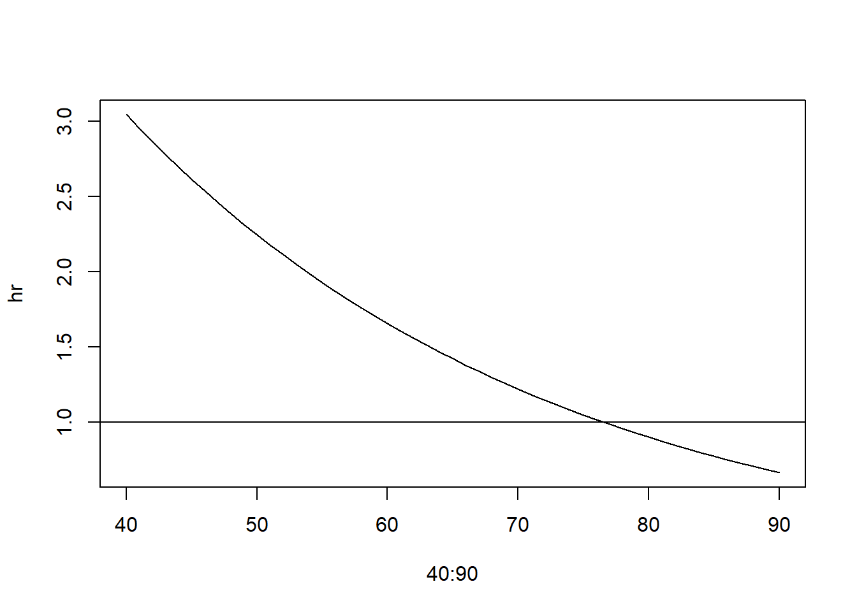
Hazard ratio for women changes with age

Slide 20
Model comparison
Wald tests
lab term estimate p.value
1 gender only genderFemale 0.38151203 0.005555126
2 age, gender age 0.06692776 0.000000000
3 age, gender genderFemale -0.06628511 0.637287208
4 bmi, age, gender bmi -0.04208396 0.006374453
5 bmi, age, gender age 0.06079117 0.000000000
6 bmi, age, gender genderFemale -0.09306460 0.509487094

Slide 21
Model comparison
Likelihood ratio, AIC, BIC
You use the log partial likelihood and/or the AIC (Akaike Information Criteria) or the BIC (Bayes Information Criteria) to compare models of different complexity.
AIC = -2 log Likelihood + 2 k.
BIC = -2 log Likelihood + log(n) k.

Slide 22
Model comparison
Likelihood ratio, AIC, BIC
lab logLik AIC BIC
1 gender only -1223.522 2449.043 2452.414
2 gender, age -1156.138 2316.276 2323.017
3 gender, age, bmi -1152.310 2310.620 2320.732

Slide 23

Model diagnostics
Martingale residuals

Slide 24
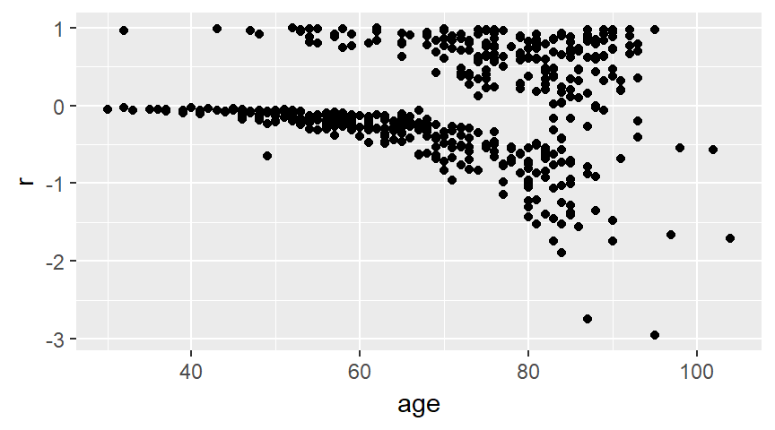
Model diagnostics, Martingale residuals

Slide 25
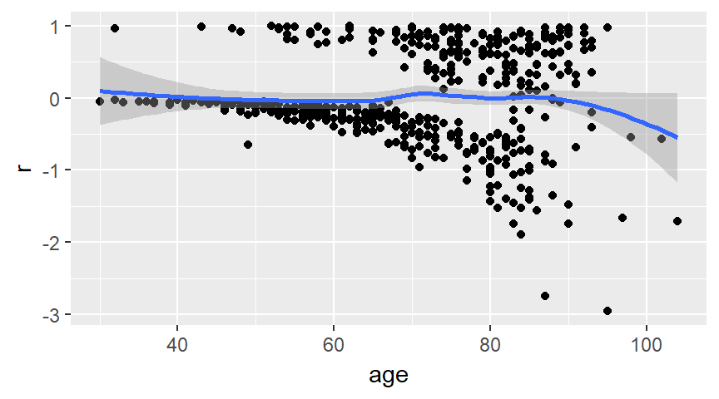
Model diagnostics, Martingale residuals

Slide 26
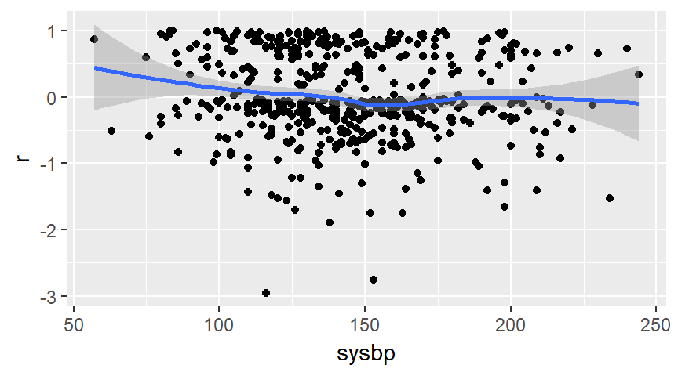
Model diagnostics, Martingale residuals

Slide 27
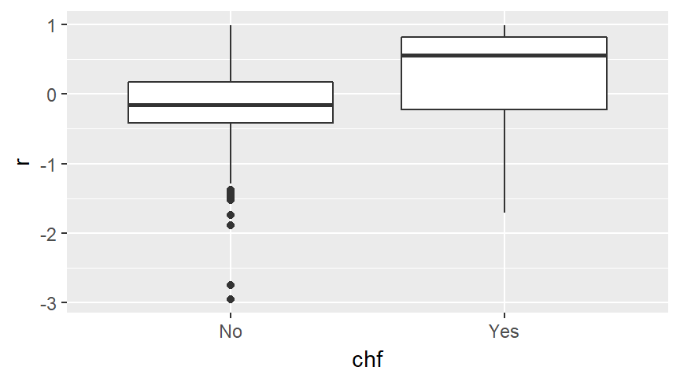
Model diagnostics, Martingale residuals

Slide 28
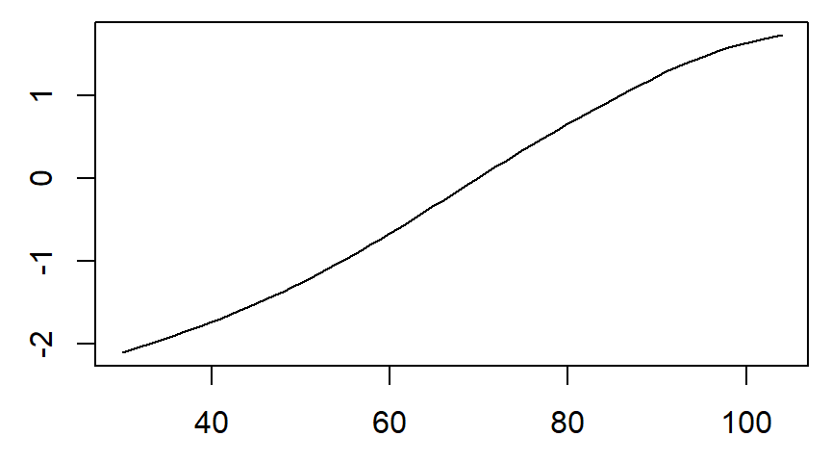
Model diagnostics, spline with df=3

Slide 29
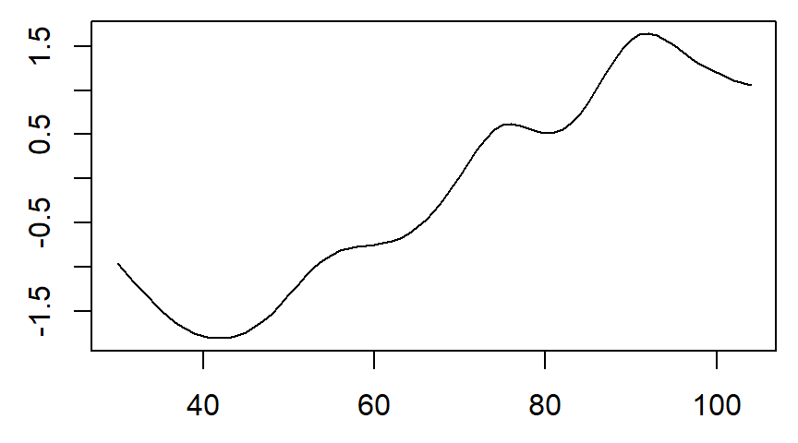
Model diagnostics, spline with df=8

Slide 30
Model diagnostics, proportional hazards
Several approaches
Patterns in Kaplan-Meier curves
Complementary log-log plot
Schoenfeld Residuals
Fit time varying covariates
Save this for another day

Slide 31
Conclusion
What have you learned today?
The Cox regression model allows for multiple independent variables and interactions.
The predicted survival curve estimated at a common covariate mean produces a risk-adjusted comparison.
A positive martingale residual implies a death earlier than expected.

